Slide 1


Wildlife Biodiversity
& National Park
Analytics
Interactive Data Analytics using Power BI
Presented by
Dhivyasree V

Slide 2
WILDLIFE ANALYTICS
Introduction
Biodiversity represents the variety of living organisms. National
parks protect wildlife and ecosystems.
01
02
03
Wildlife datasets contain
information about
species, parks, habitats
and conservation.
Data analytics helps
convert these records
into meaningful insights.
Records become
evidence for
conservation
decisions.
POWER BI · POWER QUERY · DAX

Slide 3
WILDLIFE ANALYTICS
Project Overview
A structured view of wildlife, parks and conservation patterns.
Species records
→
Power BI model
→
Interactive dashboard
STUDY
COMPARE
IDENTIFY
Species distribution,
Native / non-native, parks and
Rare and threatened species
abundance and occurrence.
categories.
patterns.
POWER BI · POWER QUERY · DAX

Slide 4
WILDLIFE ANALYTICS
Problem Statement
Wildlife data contains a large number of records and different attributes, making manual analysis difficult.
?
Major challenges:
Difficult to analyse large wildlife records.
Difficult to compare species across parks.
Difficult to identify rare and threatened species.
Difficult to understand conservation patterns.
Difficult to identify relationships between park area and species count.
Which signals are
easiest to miss in a
spreadsheet?
POWER BI · POWER QUERY · DAX

Slide 5
WILDLIFE ANALYTICS
Objectives
The analysis is designed to move from records to comparable
views.
SCOPE
PATTERNS
OUTPUT
Analyze total and unique
Compare native and
Study conservation
species
non-native species
status
Analyze parks and states
Analyze abundance,
Compare parks
Study species
occurrence and
Build an interactive
categories
seasonality
dashboard
Identify rare/threatened
species
POWER BI · POWER QUERY · DAX

Slide 6
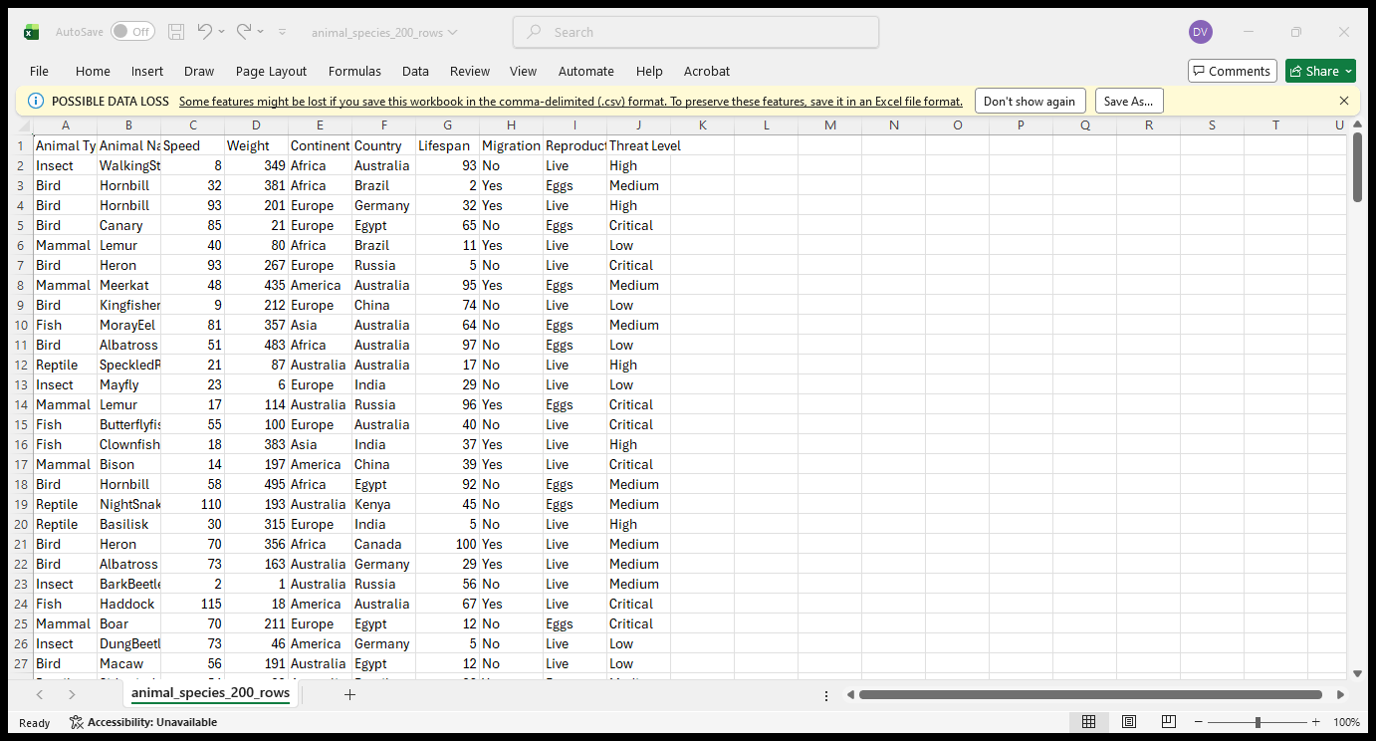
WILDLIFE ANALYTICS
Dataset Overview
Species and park-related information forms the analytical
foundation.
Species ID · Common Name · Scientific Name ·
Family · Order · Category etc…
Park Name · Park Code · State · Park Area etc..
INSERT DATASET SCREENSHOT
Native Species · Nativeness · Non-Native Species ·
Replace with a verified project visual
Rare Species etc…
Conservation Status · Abundance · Occurrence ·
Seasonality etc…
POWER BI · POWER QUERY · DAX

Slide 7
WILDLIFE ANALYTICS
02 / DATA FOUNDATION
Tools & Technologies
A Power BI workflow keeps preparation, calculation and
visualization in one analytical surface.
01
02
03
04
Power BI
Power
Query
DAX
Excel / CSV
Visualization and
Measures and KPI
Source data
dashboard
calculations
Data cleaning and
transformation
POWER BI · POWER QUERY · DAX

Slide 8
WILDLIFE ANALYTICS
Data Preparation
Used power query for data cleaning & preprocessing.
Identified the column containing blank value.
Replaced blank values in the important categorical columns.
Abundance Unknown
Seasonality Not seasonal
Conservation Status Not Evaluated.
POWER BI · POWER QUERY · DAX

Slide 9
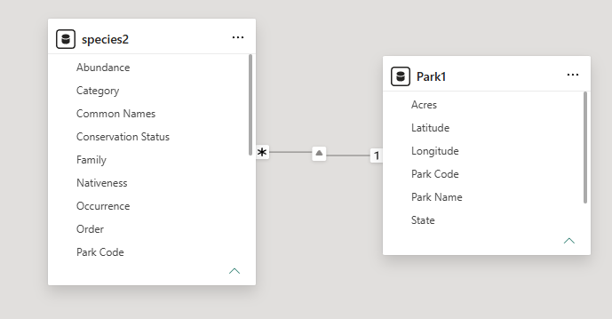
WILDLIFE ANALYTICS
Data Modelling
Create a suitable Power BI data model using species and park
information.
RELATIONSHIP KEYS
Park Code / Park Name
SPECIES GRAIN
INSERT MODEL SCREENSHOT
Species ID where applicable
Replace with a verified project visual
Relationships should reflect the level at
which each record is stored.
POWER BI · POWER QUERY · DAX

Slide 10
WILDLIFE ANALYTICS
DAX & KPI Development
Use DAX measures for dashboard calculations. Do not insert
invented KPI values.
KPIS
DAX
[value]
[value]
[value]
TOTAL SPECIES
UNIQUE SPECIES
TOTAL PARK
Measures keep KPI logic
reusable across pages
and filters.
VERIFIED VALUES ONLY
POWER BI · POWER QUERY · DAX

Slide 11
WILDLIFE ANALYTICS
Dashboard Structure
The dashboard contains 3 pages.
01
02
03
Wildlife
Overview
Park Explore
Conservation
Analysis
POWER BI · POWER QUERY · DAX

Slide 12
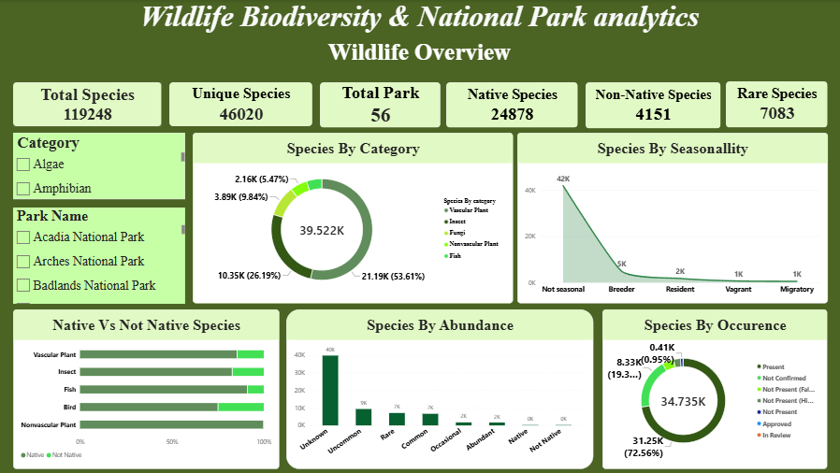
WILDLIFE ANALYTICS
01 / DASHBOARD
Wildlife Overview
A high-level view of species composition, presence patterns
and filters.
Species by Category
Species by Seasonality
Native vs Non-Native Species
Abundance · Occurrence
FILTERS: CATEGORY · PARK NAME
POWER BI · POWER QUERY · DAX

Slide 13
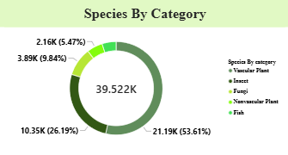
WILDLIFE ANALYTICS
Species by Category
Shows the distribution of species across wildlife categories and
helps understand biodiversity composition.
READING THE VISUAL
Compare category volume, then
use filters to isolate a park or
category.
POWER BI · POWER QUERY · DAX

Slide 14
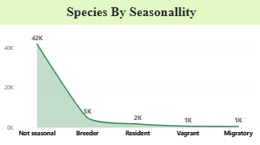
WILDLIFE ANALYTICS
Species by Seasonality
Shows how species are distributed according to seasonal
patterns and helps identify seasonal wildlife trends.
READING THE VISUAL
Seasonality groups make
recurring patterns visible
without scanning individual
records.
A
B
C
D
E
POWER BI · POWER QUERY · DAX

Slide 15
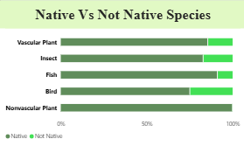
WILDLIFE ANALYTICS
Native vs Non-Native Species
Compares native and non-native species to understand
species composition and nativeness.
Native Species
Non-Native Species
POWER BI · POWER QUERY · DAX

Slide 16
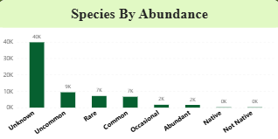
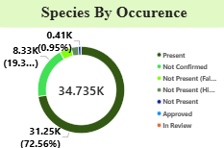
WILDLIFE ANALYTICS
Abundance & Occurrence
Abundance represents the recorded level of species presence.
Occurrence represents the frequency/pattern of species
records.
ABUNDANCE
OCCURRENCE
ILLUSTRATIVE STRUCTURE · REPLACE
WITH DATASET VALUES
ILLUSTRATIVE STRUCTURE · REPLACE
WITH DATASET VALUES
Recorded level of species presence
Frequency / pattern of species records
POWER BI · POWER QUERY · DAX

Slide 17
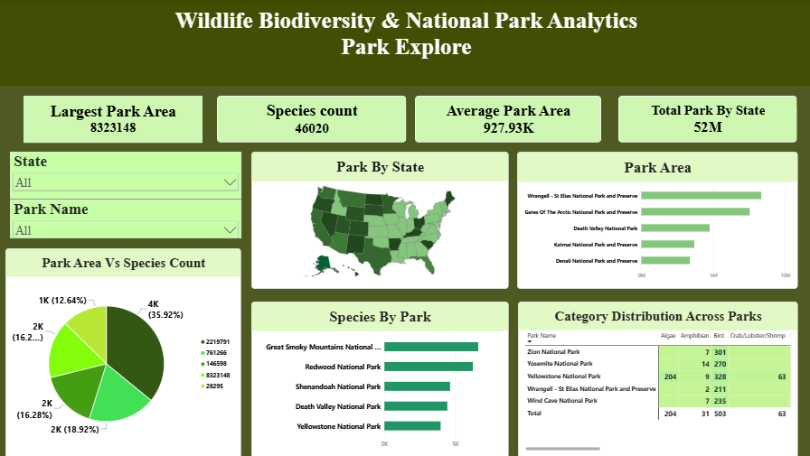
WILDLIFE ANALYTICS
Park Explore
Analyze parks using state, park name, park area and species
distribution.
Park by State
Park Area
Park Area vs Species Count
INSERT PAGE 2 SCREENSHOT
Species by Park
Replace with a verified project visual
Category Distribution Across Parks
FILTERS: STATE · PARK NAME
POWER BI · POWER QUERY · DAX

Slide 18
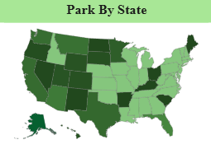
WILDLIFE ANALYTICS
Park by State
Shows the distribution of national parks across states.
ANALYTICAL USE
Compare park representation by state
and then drill into individual park
records.
ILLUSTRATIVE STRUCTURE · REPLACE WITH
DATASET VALUES
POWER BI · POWER QUERY · DAX

Slide 19
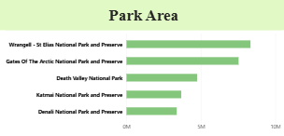
WILDLIFE ANALYTICS
Park Area
Use park area as a comparison field for understanding the scale
of protected spaces.
PARK AREA DISTRIBUTION
[area]
Insert verified unit and
range from the dataset.
POWER BI · POWER QUERY · DAX

Slide 20
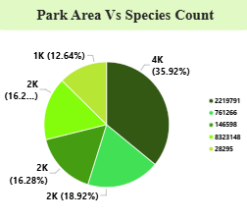
WILDLIFE ANALYTICS
Park Area vs Species Count
Study the relationship between park area and species count
without assuming a causal relationship.
INTERPRETATION
A pie chart view helps reveal
concentration, spread and possible
outliers.
PARK AREA
POWER BI · POWER QUERY · DAX

Slide 21
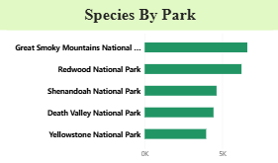
WILDLIFE ANALYTICS
Species by Park
Compare species records across parks and identify where
composition differs.
PARK
The same species lens can be
applied park by park.
ILLUSTRATIVE STRUCTURE · REPLACE WITH DATASET
VALUES
POWER BI · POWER QUERY · DAX

Slide 22
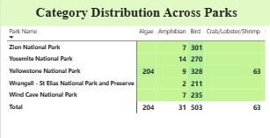
WILDLIFE ANALYTICS
Category Distribution Across Parks
Compare category mix to see how biodiversity composition
changes by park.
Compare category presence
Spot concentrated categories
INSERT CATEGORY-BY-PARK CHART
Use park and state filters
Replace with a verified project visual
POWER BI · POWER QUERY · DAX

Slide 23
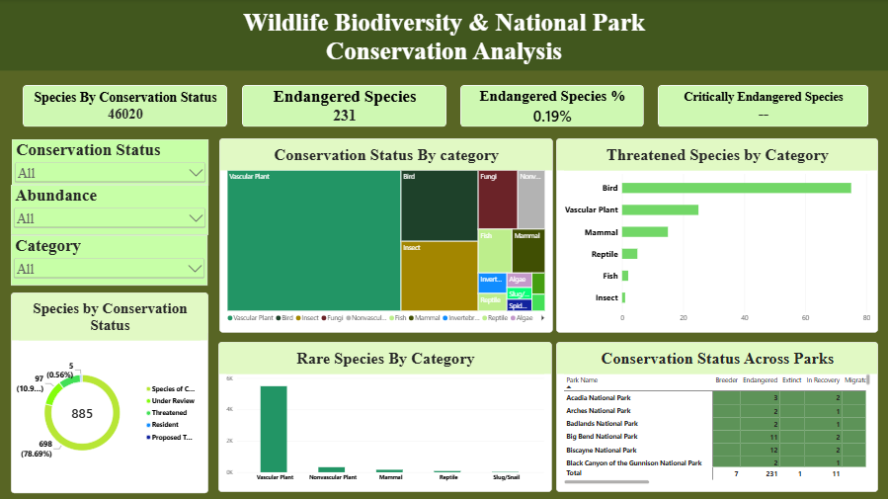
WILDLIFE ANALYTICS
Conservation
Analysis
From status labels to rare species, the final
dashboard page focuses attention on
conservation context.
POWER BI · POWER QUERY · DAX

Slide 24
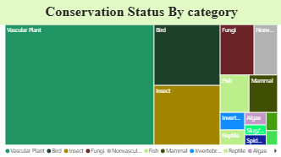
WILDLIFE ANALYTICS
Conservation Status
Analyze how species records are distributed across
conservation status categories.
USE THE VIEW TO
Compare status categories and filter
the result by park, state or species
category.
ILLUSTRATIVE STRUCTURE · REPLACE WITH
DATASET VALUES
POWER BI · POWER QUERY · DAX

Slide 25
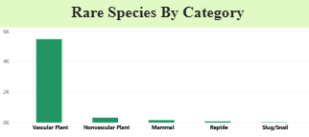
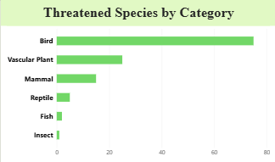
WILDLIFE ANALYTICS
Rare & Threatened Species
Identify rare and threatened species for focused review.
Cross-check rare records with
Conservation Status before drawing
conclusions.
POWER BI · POWER QUERY · DAX

Slide 26
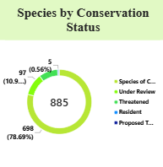
WILDLIFE ANALYTICS
Species by conservation Status
Presence patterns can be reviewed alongside conservation
categories.
POWER BI · POWER QUERY · DAX

Slide 27
WILDLIFE ANALYTICS
Conclusion
Power BI brings wildlife records, park context and conservation
fields into one interactive analytical view.
01
02
03
Clean data supports
DAX measures keep KPI
Dashboard views make
clearer analysis.
logic consistent.
comparisons easier to
communicate.
POWER BI · POWER QUERY · DAX

Slide 28
WILDLIFE ANALYTICS
References
Add the final source list used for the dataset, definitions and
methodology.
DATASET SOURCE
METHOD REFERENCES
Dataset Source : Kaggle
Data Used: Wildlife & National Park dataset.
Insert Power BI, Power Query and DAX
references
REPLACE PLACEHOLDERS WITH VERIFIED CITATIONS BEFORE SUBMISSION.
POWER BI · POWER QUERY · DAX

Slide 29
WILDLIFE ANALYTICS
Thank You
Wildlife Biodiversity & National Park Analytics
POWER BI · POWER QUERY · DAX

